Slide 1
WICKEDRIDE
ADVENTURES
A
SUCCESS
STARTUP
STORY

Slide 2
HISTORY
BEGINNING OF IDEA
STARTUP
EXPANSION
EDUCATION
ROCKBOTTOM
COMPETITORS
GROWTH
B-INFINITY
CONTROVERSY
PRESENT & FUTURE GOALS
TABLE OF CONTENTS

Slide 3
HISTORY
WickedRide Adventure Services Pvt. Ltd., was co-founded in 2014 by Vivekananda Hallekere, (CEO and co-founder) Anil G, (COO and co-founder) and Varun Agni (CTO and co-founder) initially as a luxury bike rental service under the name, WickedRide.
The company claims that it was the first and the largest luxury bike rental company in India. they launched Metro Bikes, to provide last and first mile connectivity to people looking to use public transport or to commute within the city. In September 2018, after a beta stage, they renamed this service to Bounce and with a fleet of 200 scooters introduced a dockless and keyless bike sharing service to the city of Bengaluru.

Slide 4
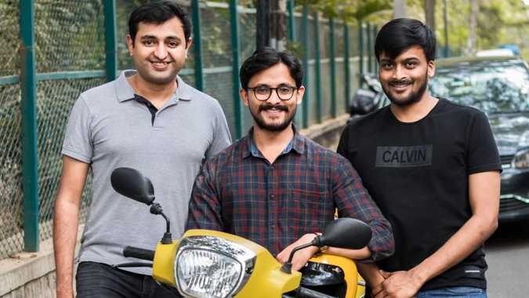
WICKEDRIDE - THE BEGINNING OF AN IDEA
The startup story of Wicked Ride started when co-founder Anil G. had to wait nearly a year to receive the Royal Enfield that he ordered.
They realised that this issue was probably prevalent for any high-end bike.
So, instead of spending several lakhs of rupees on it and then waiting for months and months to arrive, they gave people the option to rent it. And finally, in 2014, they started the premium bike rental service called Wicked Ride.

Slide 5
EARLIER STAGE OF STARTUP
For the first few months, they operated using the revenue from Wicked Ride, and they invested in around 20 scooters with it. In the subsequent months, they raised around Rs 12 lakhs from Toyota Mobility Foundation.
It was one of the first corporate investments into the startup. They invested in a simulation program with that funding. Their team worked with people on the ground to handle giving out the keys, filling out minor paperwork, and later receiving the bikes.
This renting program stretched from Byapannahalli Metro station to Whitefield, a route usually covered in two hours by a car

Slide 6
HOW THEY EXPANDED
In 2019, they launched operations in Hyderabad with 2000 dockless scooters and plan to introduce electric scooters to the market soon. In March 2020, Bounce claims to have started doing more than 130,000 rides a day and to have clocked more than 10 million rides since inception in September 2018. The company also claims to have grown into the world's fastest-growing bike-sharing start-up.
In January 2020, Bounce raised ₹692.39 crore (approximately USD 92 million) in a Series D round led by Facebook co-founder Eduardo Saverin’s VC fund B Capital, and is currently valued at over USD 520 million.

Slide 7
WHAT ABOUT THEIR STUDIES
Varun Agni
Anil G
Vivekananda H
Completed His Graduation
In Southeastern Illinois College
Completed Graduation at The Institute Of Company
Secretaries Of India
Completed His CA In The Institute Of Chartered Accountants Of India

Slide 8
BOUNCE A SUCCESSFUL INITIATIVE
ROCK BOTTOM TO EVERYONE
“When Bangalore’s (Bengaluru) Metro train started operating, we saw it was difficult for people to find auto rickshaws or other public transport from Metro stations to their homes,” Anil said in an interview.
With WickedRide Adventure co-founders—schoolmate Vivekananda Hallekere, and friend Varun Agni— Anil founded Bounce, formerly known as Metro Bikes.

Slide 9
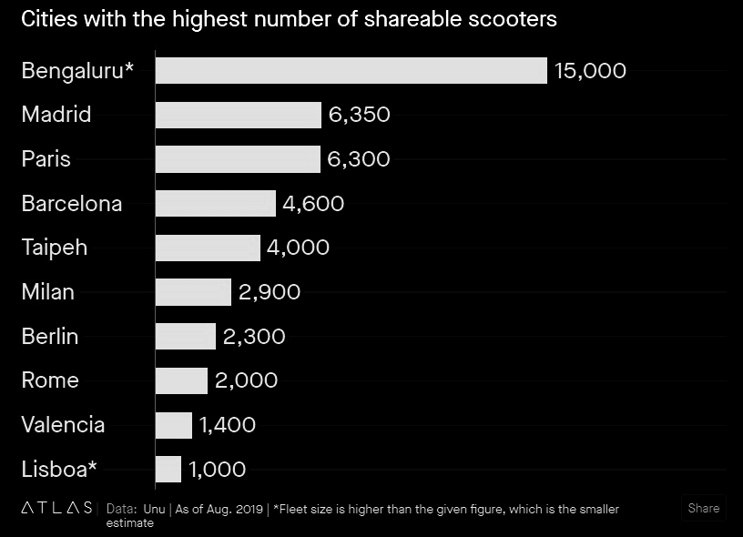
The fleet is almost entirely based in India’s tech capital, Bengaluru, which is also home to the country’s two biggest scooter sharing apps, Bounce and Vogo. “Bengaluru is, as of 2019, by far the global scooter sharing capital,” says the report.

Slide 10
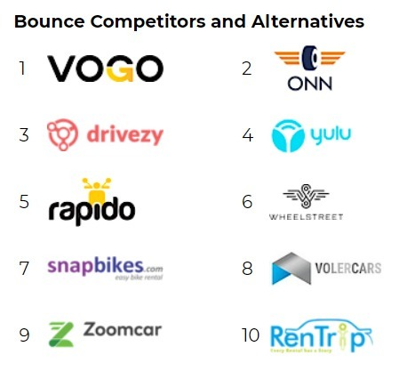
COMPETITORS FOR BOUNCE

Slide 11
STRATEGIES TO BEAT COMPETITORS
Wicked Ride is focusing on bringing the best of motorcycling on one platform and make it easily accessible.
They have started an utility arm called “ApnaRide”, a platform where you can rent scooters and motorbikes such as Honda Activa, Bajaj Avenger, Electric Bikes and Bicycles.
Wicked Ride also has been working closely with various agencies in solving the last mile connectivity problems seen in metros and Tier II cities.
They also conduct Guided Adventure Motorcycle Tours to Many Places across India and Beyond. Giving one an exhilarating experience of exploring our beautiful country with the thrill and convenience that only a motorcycle can offer.

Slide 12
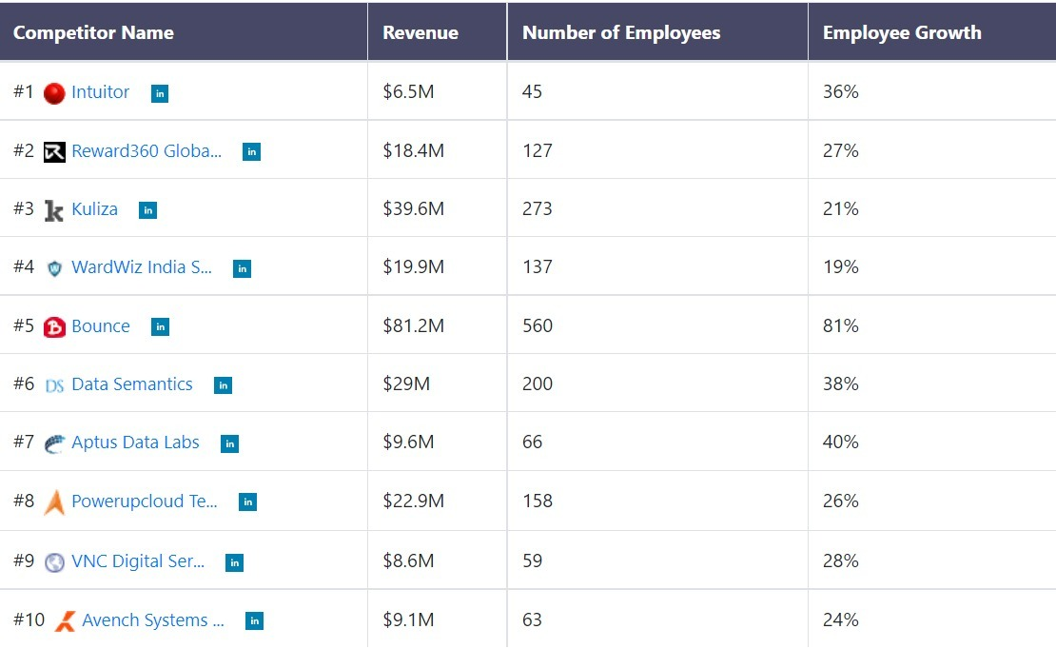
GROWTH OF BOUNCE
Notes:
This employment growth rate of bounce clearly shows us how the employment has been boosted during the recent years which helps a lot to increase our country employment rate which in turn provides economical growth i.e GDP of the country.

Slide 13
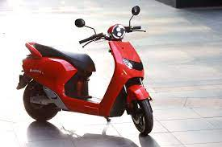
B-INFINITY (POWER TO THE PEOPLE)
This bike rental company has launched its first electric scooter, Infinity E1. After Ola had launched the S1 & S1 Pro electric scooters.
It could be a shock and surprise that the company was able to bring out an electric vehicles this quick.

Slide 14
ADOPTION TO PANDEMIC
During the pandemic, they took various efforts to market that they were taking great care of their customers by thoroughly sanitized scooters using an antimicrobial solution.
They also ensured that their team is using face mask and gloves all the times. They made compulsory use of Aarogya Setu app by ground staff and they also encouraged users to sanitize before and after each ride.

Slide 15
Bounce has raised a total of $214.2 million in funding over 9 rounds. Their latest funding was raised on Mar 3, 2020 from a Debt Financing round.
Bounce is funded by a total of 17 investors. InnoVen Capital and B Capital Group are the most recent investors.
F
U
N
D
I
N
G

Slide 16
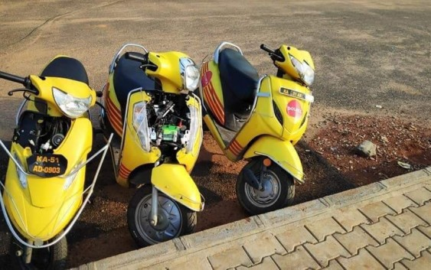
CONTROVERSY
Once there was a major controversy when a series of pictures showing vandalized Bounce bikes in Bangalore has gone viral. The pictures show the yellow-and-red bikes vandalized to varying degrees, and left then to their own devices.
Some bikes have had their tyres removed, and were photographed sitting by the side of the road. Other bikes seem to have been stripped of their tyres and then abandoned. Some bikes have had it even worse, there are bikes pictured which have been opened up, and their engines removed and stolen.
India isn’t the only country where ride sharing apps have had to deal with theft and vandalism. Wukong Bike, a cycle-sharing startup in China, had to shut down after six months of operations after 90 percent of its bikes were stolen.

Slide 17
PRESENT & FUTURE GOALS
Bounce fleet of electric bikes and scooters can help you to reach your destination in no time, with zero direct vehicle emissions at almost half the cost.
This is now possible because they have designed an in-house, E scooter which is also known as the Bounce E scooter.
The scooter is robust, smart, and fully electric. With ample boot space, a light-weight body, and easily swappable batteries, the e-bike is built to suit all your needs for daily commute.
They also provide the facility of renting out your 2 wheeler to earn more money when you’re not using it.

Slide 18
REFERENCES
https://auto.hindustantimes.com/auto/two-wheelers/bounce-rides-in-infinity-electric-scooter-at-rs-68-999-takes-aim-at-ola-s1-41638432140416.html
https://startuptrak.com/bounce-lets-you-earn-money-by-renting/
https://growjo.com/company/Bounce
https://qz.com/india/1746279/indias-bengaluru-is-now-the-scooter-sharing-capital-of-the-world/
https://yourstory.com/2019/04/startup-bounce-bike-rental-platform/amp
https://cartechnewz.com/bounce-launches-its-own-electric-scooter-e1-infinity/
https://thedigitalyug.com/startup/bounce-startup-story-starting-days-challenges-and-pandemic

Slide 19
Thankyou!

